Slide 1


VERSION CONTROL WITH GIT
KISHORE DONEKAL
DEC, 2017

Slide 2
AGENDA
1
Version Control Systems
2
Git as a version control tool
3
Git setup and configuration
4
Basic flow: commit/push/pull
5
Branches and merging
6
Undoing changes
7
Best practices

Slide 3
VERSION CONTROL SYSTEMS
GOALS
Backup and Restore
Synchronization
Undo
Track Changes
Track Ownership
Sandboxing
Branching and merging
LOCK-MODIFY-UNLOCK
COMBINED
COPY-MODIFY-MERGE
VSS, VAULT
SVN, Perforce,
ClearCase, TFS
CVS, Git, Mercurial,
Bazaar

Slide 4
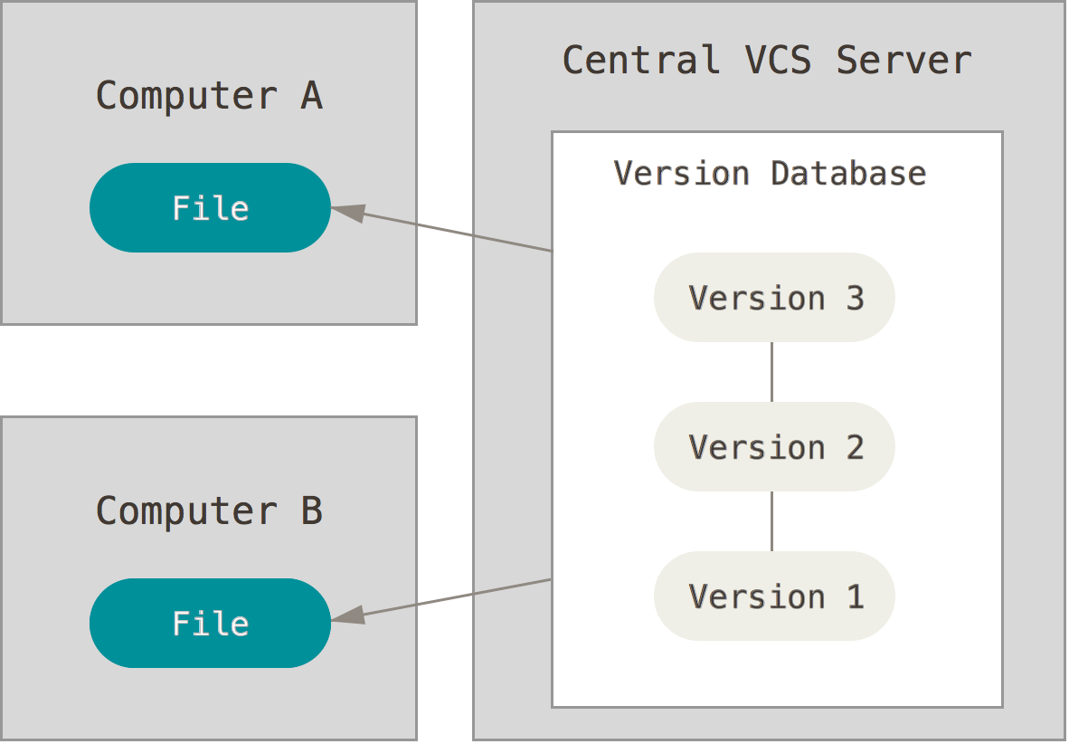
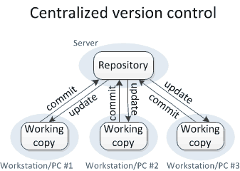
CENTRALIZED VS DISTRIBUTED

Slide 5
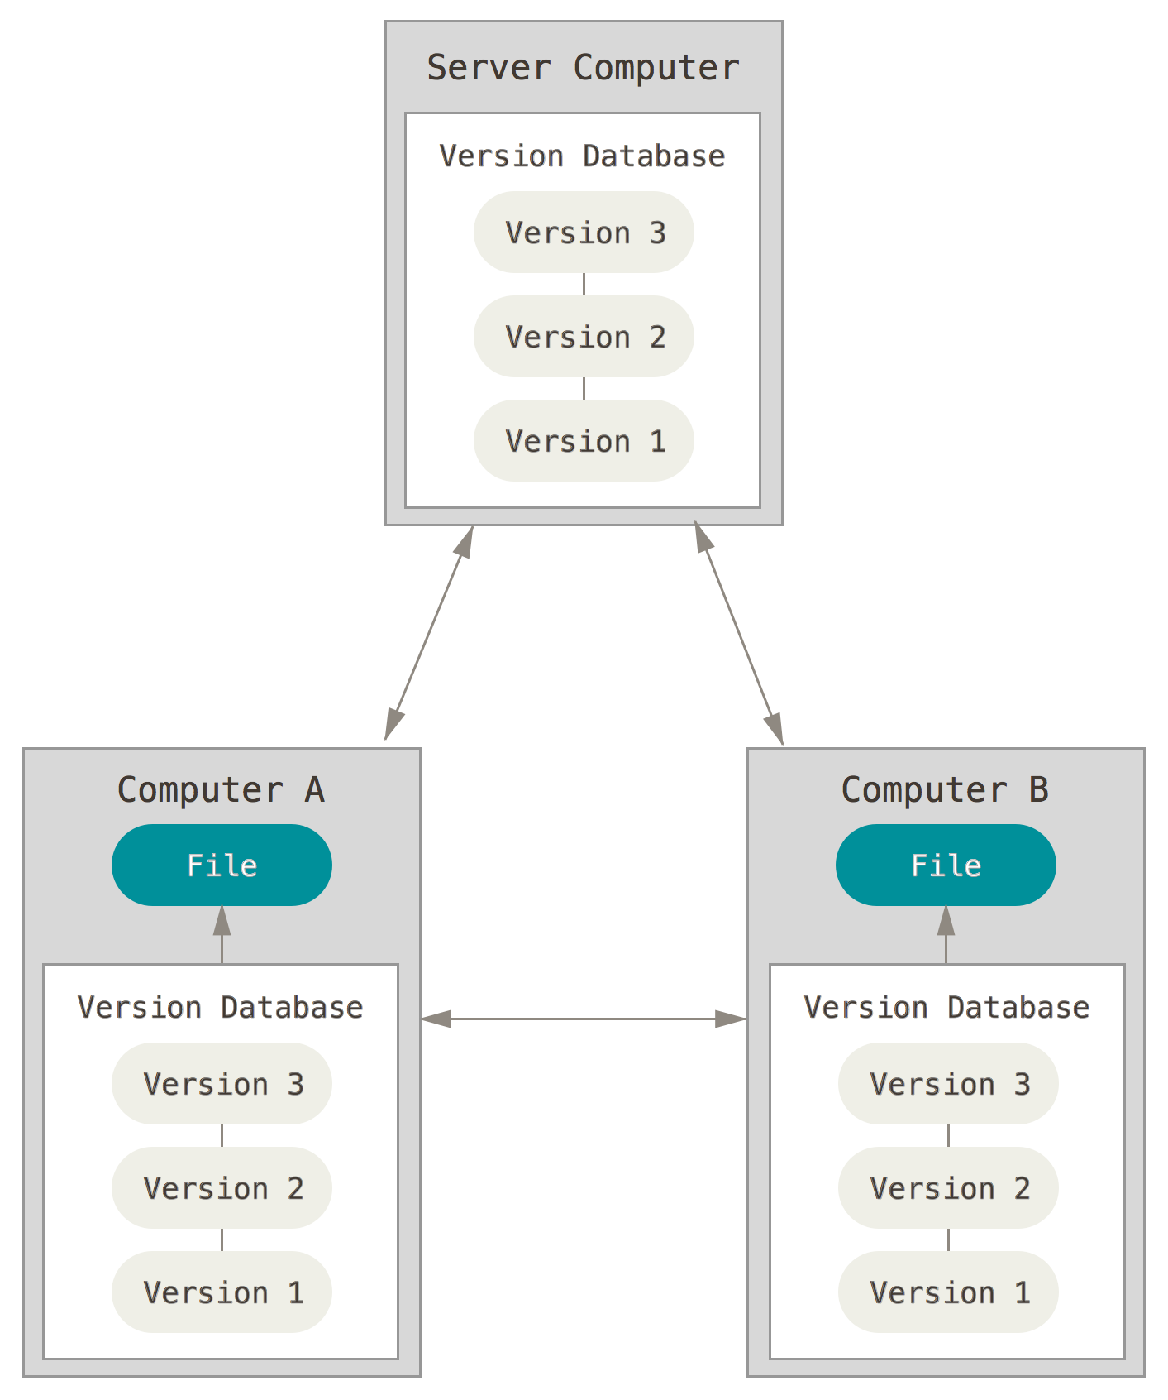
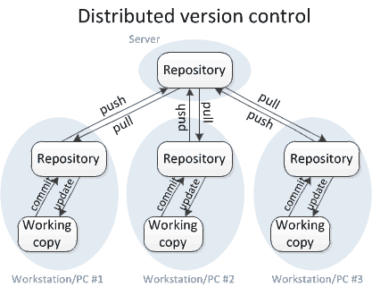
CENTRALIZED VS DISTRIBUTED

Slide 6
GIT vs SVN
GIT is Fast – Almost all operations are local.
GIT is Distributed – Entire history is maintained in local.
Size of the working copy is comparatively large.
Code can be committed even if the server is down.
History can be restored even if the server crashes
SVN is Slower – On every operation, communication between working copy and server happens.
SVN is Central – Only the current versions of files are stored in local.
Size of the working copy is smaller
Code cannot be committed until the server is up
In case the server crashes, there is no way to restore the history.

Slide 7
GIT vs SVN
GIT does not support Lock-Modify-Unlock concept
In GIT, entire repository needs to be cloned.
It is not preferred to commit binary files and large files in GIT
Adding/ Committing code to GIT involves double the no of commands
GIT repository is either public or private (Paid Service)
SVN supports Lock-Modify-Unlock concept as well
In SVN, we can checkout the sub-folders.
SVN provides better support for binary and large files
Adding/Committing code to SVN involves considerably fewer steps
SVN repository is private and free – More secure

Slide 8


GIT
Git is a free and open source distributed version control system designed to handle everything from small to very large projects with speed and efficiency.

Slide 9
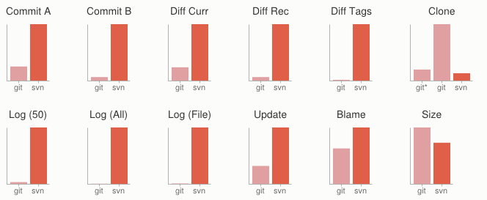
WHY GIT
Fast
Small
Distributed
Data Assurance
Free and Open Source

Slide 10

GIT SETUP
Download binary from here: http://git-scm.com/downloads
Follow the steps using the default options
Configure your identity
Generate SSH key pair
ssh-keygen -t rsa -C "your_email@example.com"
Send public key to repository owner or upload to your profile
Configure username and email
git config --global user.name "YOUR NAME“
git config --global user.email "YOUR EMAIL"

Slide 11
GIT BASE FLOW DEMO
Clone Repository
git clone <url> [--branch <branchname>] [<foldername>]
Checkout/change branch
git checkout <branchname>
Pull Remote Repository
git pull
Initialize the new git repository
git init
Add file to Staging
git add ./-A : Adds all files (Modified + Newly added)
git add –u : Adds only Modified files
git add <filename> : Adds particular file

Slide 12
GIT BASE FLOW DEMO
Commit to Staging
git commit –m “<commit message>”
Push to remote repository
git push
Check logs
git log
Create new branch
git branch origin <newbranchname> <oldbranchname>
Push branch to remote
git push –set-upstream origin <newbramchname>

Slide 13
UNDOING CHANGES
Working directory
git checkout -- file.txt
git checkout .
git clean -xdf
Staging area (Index)
git reset -- file.txt
Local branch
git reset HEAD^^ (HEAD~2)
git commit --amend -m “commit message”
Remote repository
git revert <sha1>
Through Tortoise git
Revert:
Go to file -> Tortoise Git -> Revert
Go to repository -> Tortoise Git -> Revert
Go to Repository -> Tortoise Git -> Clean up
Reset:
Go to Repository -> Tortoise Git -> Show Log -> select particular revision no -> Reset
Amend Commit:
Go to Repository -> Git Commit -> Amend last commit
Revert:
Go to Repository -> Tortoise Git -> Show Log -> Select particular revision -> Revert changes by this commit

Slide 14
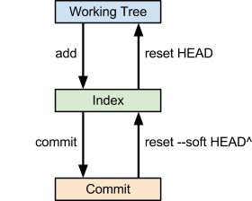
GIT RESET
Soft
Change HEAD to old SHA1
git reset --soft <sha1>
Add changes into index
Mixed (default)
Change HEAD to old SHA1
git reset -- mixed <sha1>
Do not add changes to index
Hard
Change HEAD to old SHA1
git reset -- hard <sha1>
Do not saves changes.
Do not remove the new commit, but git gc can )

Slide 15
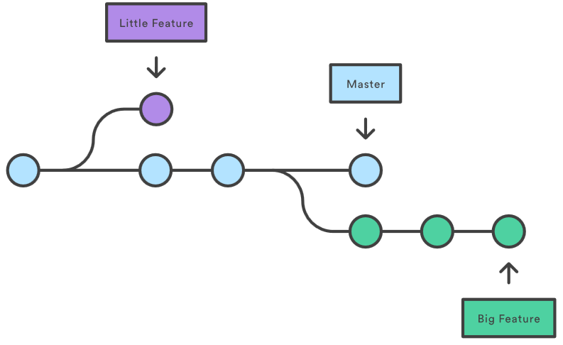
BRANCHING

Slide 16
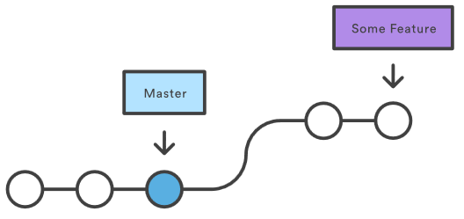
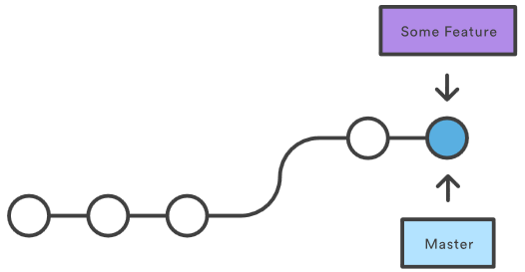
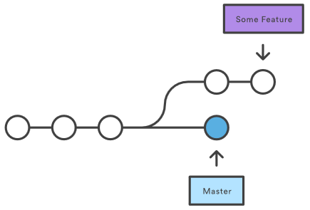
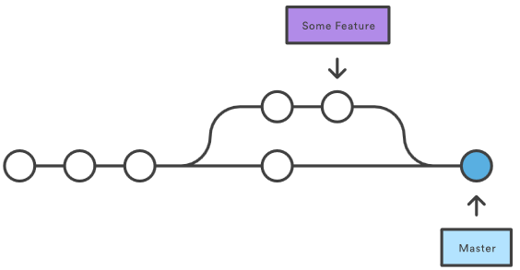
MERGING
Fast-forward merge
Do not produce additional commit
Non-ff merge
Produce additional commit with details

Slide 17
CONFLICTS
Abort merge
git merge –abort
Resolve by selecting version
git checkout --ours –theirs
Resolve manually
git diff
User merge tool
Avoid conflicts
Short commits
No edits to whitespaces
Merge often

Slide 18
GIT BEST PRACTICES
Identify yourself
Set username
Set email
Pull before push
Save you from unnecessary merges
Use default tools
If you a new to git
Do not commit garbage
Git is not the best place for logs, user settings and output binaries
Use branches
Branch is 41 bytes of memory

Slide 19


Q&A
Thank you!
• For coming today
• For asking question
Further reading:
Pro Git
Version Control with Git

